Slide 1


OPP
جامعة المرقب
كلية تقنية المعلومات
قسم هندسة البرمجيات
Constructors and Destructors
خريف 2026/2025‏

Slide 2
Class Constructer
In C++, the constructor is a special member function that is called automatically when an object is instantiated.

Slide 3
Class Constructer
Constructors can be used to allocate resources, such as file handles
constructors can initialize game entities (like players entities)

Slide 4
#include <iostream>
using namespace std;
class name {
private:
// some data
data
public:
void function
methods for do something; }}
int main() {
object objectname ;}

Slide 5
Key Features of Constructors :
#include <iostream>
using namespace std;
class Person {
public:
Person() {
cout << "Object created" << endl;
}
};
int main() {
Person p; // Object is created here
return 0;
}
.
Same Name as Class:
A constructor has the same name as the class it belongs to.

Slide 6
Key Features of Constructors :
#include <iostream>
using namespace std;
class Person {
public:
Person() {
cout << "Object created" << endl;
}
};
int main() {
Person p; // Object is created here constructor call automatically
return 0;
}
.
Automatic Invocation:
When create an object, the constructor runs automatically.

Slide 7
Key Features of Constructors :
#include <iostream>
using namespace std;
class Person {
public:
int a;
Person() {
a=5;
}
};
int main() {
Person p; // Object is created here
return 0;
}
.
Initialization:
Constructors set initial values for the object's attributes. The attribute (a) is instilized with value 5

Slide 8
Key Features of Constructors :
#include <iostream>
using namespace std;
class Person {
public:
void Person() {
cout << "Object created" << endl;
}
};
int main() {
Person p; // Object is created here
return 0;
}
.
No Return Type:
Constructors do not have a return type, not even void.

Slide 9
Key Features of Constructors :
#include <iostream>
using namespace std;
class Person {
public:
(int,string,float) Person() {
cout << "Object created" << endl;
}
};
int main() {
Person p; // Object is created here
return 0;
}
.
.
No Return Type:
Constructors do not have a return type, not even void.

Slide 10
Types of Constructors :
class Example {
public:
Example() {
// Default Initialization}
};
class Example {
public:
Example(int x, int y) {
// Initialization with parameters
}
};
Default constructer A constructor that does not take any parameters.
Parameterized Constructor It’s a constructor that accepts values (parameters) to create an object with those specific values..
1
2

Slide 11
Exampl1 : Calculates Rectangle area. By using Default C++ Constructor with No Parameters
#include <iostream>
using namespace std;
class Rectangle {
private:
int width, length;
public:
Rectangle() {
width = 5;
length =10;
cout << (length*width)<<endl; }};
int main() {
Rectangle rect1;}
When Rectangle rect1 is created:
constructor runs automatically
Sets default values for length and width
No need to call any special method

Slide 12
Exampl1 : calculates Rectangle area a Uses a parameterized constructor to set length and width
#include <iostream>
using namespace std;
class Rectangle {
private:
int width, length;
public:
Rectangle(int w, int l) {
width = w;
lengtht =j;
cout<<length*width<<endl;}};
int main() {
Rectangle rect1(5,10);
Rectangle rect1(8,12);
return 0; }
When Rectangle rect1(5,10); is created:
Constructor receives w=5, l=10
Sets width=5, height=10
Output: : 50
When Rectangle rect2(8,12); is created
Constructor receives w= …. , l=…..
Sets width=….., height=……
Output: ……………..

Slide 13
Exampl3 : calculates Rectangle area automatically Uses a parameterized constructor to set length and width
#include <iostream>
using namespace std;
class Rectangle {
private:
int width, length ;
public:
Rectangle(int w=8,int l=9) {
width = w;
length =l;
cout << (length*width)<<endl;}};
int main() {
Rectangle rect1; return 0; }
rect2: Uses default values
→ 8 × 9 = Area: 72

Slide 14
Constructor Overloading
class Rectangle {
private:
int width, length;
public:
Rectangle() {
width = 5;
length = 7; }
Rectangle(int w, int h) {
width = w;
height = h; }
void display() {
cout << (length*width)<<endl;
}};
int main() {
Rectangle rect1;
Rectangle rect2(5,8);
rect1.display();}
Constructor overloading allows a class to have multiple constructors with different parameters.
This allows you to create objects in different ways

Slide 15
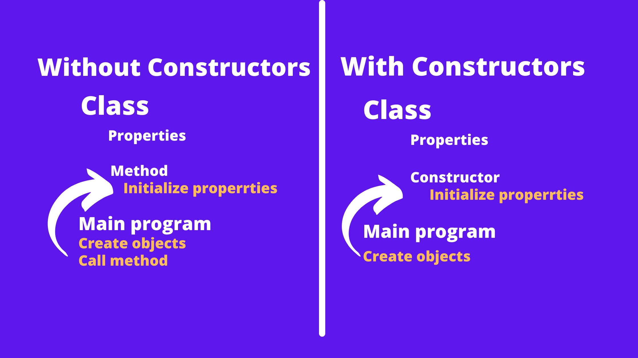
Question1:What different between them?

Slide 16
Questions:
1
Fill in the blanks to define the class with its constructor
2
When is the constructor called?
A) When the class is declared
B) When an object of the class is created
C) Never
-------my_class {
private:
int my_data;
public:
my_class(____ arg) {
my_data = ----------
}
};

Slide 17
Questions Find the mistakes and correct it
1
2
Class student {
private:
int my_data;
public:
void student(int x ) {
my_data = x;
}
};
Class student {
private:
int my_name;
public:
Student(string name) {
my_name= name;
}
};

Slide 18
Class destructor
Remember constructors? They're special member functions that are automatically called when an object is created.
Destructors are special functions, as well. They're called when an object is destroyed or deleted……

Slide 19
When is destructor called?
It mean that a destructor function is called automatically when the object goes out of scope: (1) the function ends (2) the program ends

Slide 20
Key Features of destructors
A constructor has the same name as the class, only prefixed with a tilde(~)
#include <iostream>
class MyClass {
public:
~MyClass() {
cout << "Destructor called: Object destroyed." << std::endl;
}

Slide 21
Key Features of destructors
The destructor does not have parameter
#include <iostream>
class MyClass {
public:
~MyClass( parameters ) {
cout << "Destructor called: Object destroyed." << std::endl;
}

Slide 22
Key Features of destructors
The destructor does not have parameter
#include <iostream>
class MyClass {
public:
~MyClass() {
cout << "Destructor called: Object destroyed." << std::endl;
}

Slide 23
Key Features of destructors
It has no return type not even void
#include <iostream>
class MyClass {
public:
~void MyClass() {
cout << "Destructor called: Object destroyed." << std::endl;
}

Slide 24
Key Features of destructors
It has no return type not even void
#include <iostream>
class MyClass {
public:
~ MyClass() {
cout << "Destructor called: Object destroyed." << std::endl;
}

Slide 25

Key Features of destructors
It can not be overloaded
#include <iostream>
class MyClass {
public:
~ MyClass() {
cout << "Destructor called: Object destroyed." << endl;
~ MyClass() {
cout << "Destructor called: Object destroyed." << endl;
}
}

Slide 26
Question
Which statement about C++ constructors and destructors is correct?
A constructor is executed when an object is created; a destructor is executed when the object is destroyed.
A constructor is executed when an object is deleted.
A destructor is executed when an object is created.:

Slide 27
example 1
Write a C++ program, it defines a class named Counter(integer , float , characters) with multiple constructors(overloaded) and includes a main function to demonstrate its usage.

Slide 28
ex
#include <iostream>
class Counter {
private:
int i;
double d;
char c;
public:
Counter (int a) {
i = a;
cout << "Integer: " << i << endl;}
Counter (double b) {
d = b;
cout << "Double: " << d << endl;
}
Counter (char character) {
c = character;
cout << "Character: " << c << endl;
};
~ Counter (){
cout <“ Constrictors deleted “<<endln;}
int main () {
Counter obj1(5); // Calls the integer constructor
Counter obj2(6.4); // Calls the double constructor
Counter obj3('A'); // Calls the character constructor
Return 0;
}

Slide 29
ex
#include <iostream>
class Counter {
private:
int i;
double d;
char c;
public:
Counter (int a) {
i = a;
cout << "Integer: " << i << endl;}
Counter (double b) {
d = b;
cout << "Double: " << d << endl;
}
Counter (char character) {
c = character;
cout << "Character: " << c << endl;
};
~ Counter (){
cout <“ Constrictors deleted “<<endln;}
int main () {
Counter obj1(5); // Calls the integer constructor
Counter obj2(6.4); // Calls the double constructor
Counter obj3('A'); // Calls the character constructor
Return 0;
}

Slide 30
example 2
C++ program to calculate the area of a Triangle using constructors and destructor

Slide 31
ex
class Triangle {
private:
float a, b, c; public:
Triangle (float x, float y, float z) {
a = x; b = y; c = z;
}
void area () {
float s = (a + b + c) / 2;
float areaValue = sqrt (s * (s - a) * (s - b) * (s - c));
cout << "Area = " << areaValue << endl;
}
~Triangle() {
cout << "Destructor called" << endl; } };
int main () {
Triangle obj (10, 10, 10);
obj. area ();
return 0; // - obj goes out of scop
// Destructor called automatically here
}

Slide 32
ex
Summary Table
#
Feature | Constructor | Destructor
Purpose | Initialize object | Clean up resources
When called | Object creation | Object destruction
Name | Same as class | Same as class with ~
Return type | No return type | No return type
Parameters | Can have parameters | No parameters
Overloading | Can be overloaded | Cannot be overloaded
Calling | Automatic | Automatic
Memory | Allocate resources | Free resources
!

